Slide 1
FINMENTOR AI - MULTIAGENT FINANCIAL
ADVISORY PLATFORM
Under the Guidance of
Dr. Apash Roy
Associate Professor
Department of Data Science & Statistics
Submitted by:
Roshan Varghese, 2448046
Varun Dsouza, 2448059

Slide 2
Multiagent Financial Advisory Platform
In modern times there are different asset classes to appreciate capital of an individual. Capital market is one such proven way.
NIFTY-50 which is the benchmark index of top 50 companies in India has generated a return of 10% CAGR. Where as many small cap companies have generated a hefty return of 15% to 18% in the same time.
FinMentor AI MVP is a standalone web application designed to provide basic financial education and advisory services to Indian retain investors.
The chatbot is designed to build sophisticated portfolio based on an investors risk perception.
In addition to building portfolio, the application is capable of educating new investors and giving summary of annual reports.

Slide 3
Problem Statement
THE FINANCIAL LITERACY GAP IN INDIA
Only 27% of Indian adults are financially literate (NCFE Survey 2023)
Retail investors lack personalized guidance
Traditional financial advisors are expensive (₹5000-10000/consultation)
Generic investment apps don't educate users
Information overload - 5500+ stocks on BSE, where to start?
Real-World Impact:
Poor investment decisions due to lack of knowledge
Missed wealth creation opportunities
Emotional investing (panic selling, FOMO buying)
No understanding of risk-return tradeoffs
Target Users: Young professionals (20-45) entering capital markets

Slide 4
Why Existing Solutions Fall Short
Robo-Advisors (Zerodha Coin, Groww):
Automated portfolio suggestions
No educational component
One-size-fits-all approach
No conversational interface
Financial Chatbots (MoneyBot, Fina):
Answer basic questions
Limited to FAQs
No portfolio building capability
No context awareness
Human Financial Advisors:
Personalized advice
Expensive (₹5000+/session)
Not scalable
Not available 24/7
THE GAP: No solution combines education + advisory + personalization + 24/7 availability + affordable cost

Slide 5
Project Objectives
Intelligent multi-agent financial advisory: Creates a system with specialized AI agents that collaborate to provide comprehensive financial advice. Developed smart orchestration with dependency aware execution.
Context aware conversational memory: To build a system that remembers and learns from past conversations. Implement agentic RAG with PGVector semantic search. Intent classification with 6 query types.
Real-time market integration: This provides accurate an up-to-date market data and analysis. Yahoo finance integration for live stock prices. Technical indicator calculations such as RSI, MACD, Moving average.
Educational financial platform: Make financial literacy accessible to everyone. Angel one scraped data that contains more than 500 terms.

Slide 6
Literature Review - Multi-Agent Systems in Finance
1. Multi-Agent Trading Systems
Reference: Xiao et al. (2024) - "TradingAgents: Multi-agents
LLM financial trading framework"
Key Findings:
Specialized agents outperform single-agent systems
Agent collaboration improves decision accuracy by 23%
LLM-based agents can process unstructured financial data
https://arxiv.org/abs/2412.20138
2. RAG for Financial QA
Reference: Choi et al. (2025) - "FinDER: Financial dataset for
question answering and evaluating RAG"
Key Findings:
RAG improves factual accuracy in financial responses
Retrieval-based methods reduce hallucinations
Domain-specific knowledge bases essential
https://arxiv.org/abs/2504.15800
3. LLM-Based Portfolio Recommendations
Reference: Lopez-Lira, A., Scheer, M., & Schwenkler, G. (2024) - "Using Large Language Models for Financial Advice"
Key Findings:
LLMs can generate implementable portfolio recommendations with specific securities and weights
Foundation models generate portfolios more sensitive to investor characteristics than fine-tuned models
https://papers.ssrn.com/sol3/papers.cfm?abstract_id=4850039
4. GenAI and Retail Investor Behavior
Reference: Cao, S., Jiang, W., & Wang, J. (2024) - "Generative AI and Investor Processing of Financial Information"
Key Findings:
Nearly 50% of retail investors already use GenAI for financial information processing
GenAI enhances ability to process complex financial information quickly
More sophisticated investors leverage GenAI for complex tasks more effectively
https://papers.ssrn.com/sol3/papers.cfm?abstract_id=5053905

Slide 7
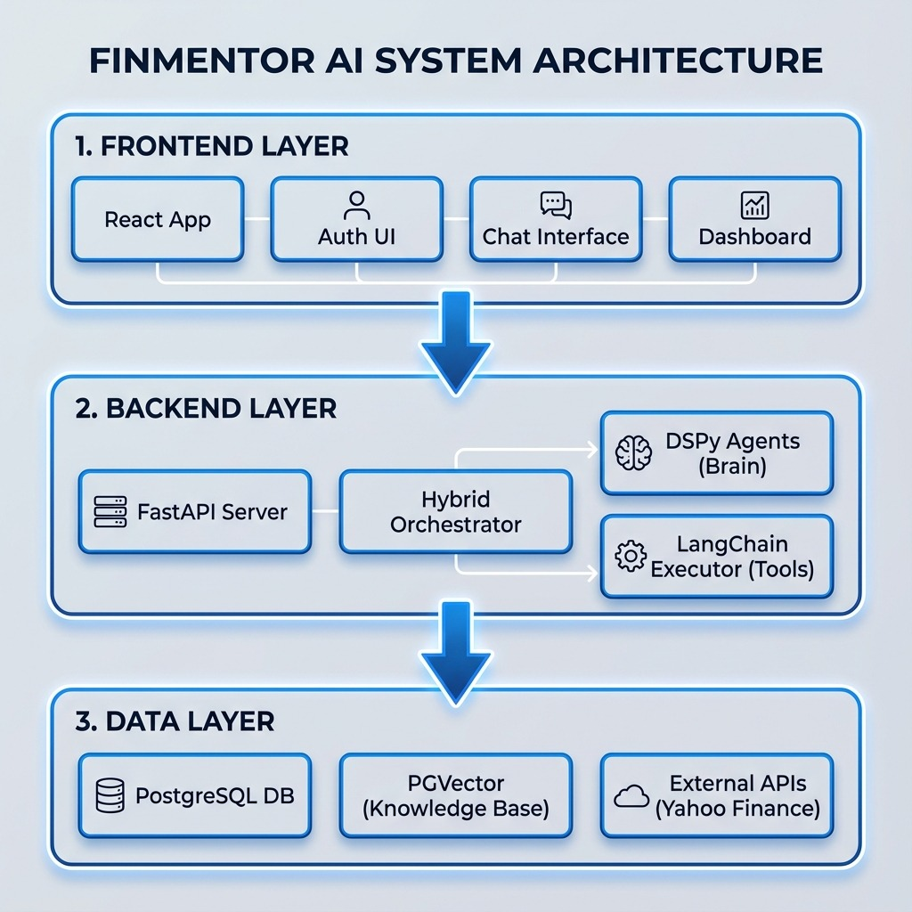
System Architecture
Frontend Layer: React web application
Application layer: Fast API with python.
Data layer: Sources
  Yahoo Finance - Free, real-time Indian market data
  Angel One - 538 financial terms scraped for education
  Alpha Vantage - Rate limits too restrictive
  NSE Direct API - Requires commercial license

Slide 8
Data Collection & Processing (EDA)
Data Source: Angel One Financial Glossary
Method: Web scraping with Python (Selinium)
Dataset Statistics:
Total Terms: 538 financial terms
Columns: term, definition, url, source
Data Quality: 100% complete (no missing values)
Duplicates: Removed during preprocessing
Key Topics Covered (Word Cloud Analysis):
Most Frequent: FINANCE, TRADING, TAXES, CREDIT, INSURANCE, STOCK, OPTION, FUTURE
This forms our Educational Agent's knowledge base
Content Analysis:
Average Term Length: 15 characters
Average Definition: 784 characters
Consistency: 95% definitions 700-900 chars
Distribution:
• Banking & Finance: 28%
• Trading Instruments: 24%
• Tax & Legal: 18%
• Investment Products: 30%

Slide 9
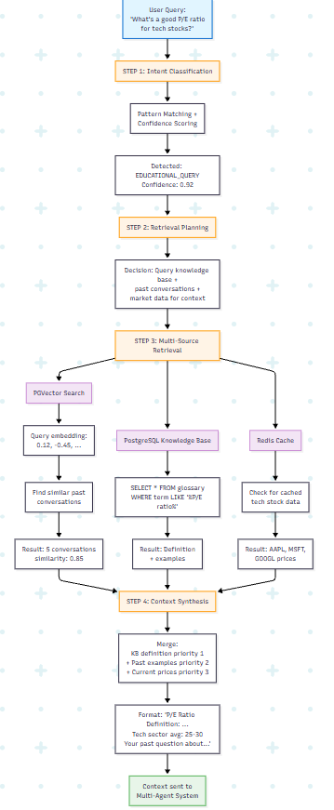
RAG architecture
Intent Classifier
  Historical references: Past conversation recall
  Education Query: Learning financial concepts.
  Market analyser: Real time stock data.
  Portfolio advice: Investment recommendation.
  Risk assessment: Risk evaluation.
Risk planner
  Creates retrieval strategy based on intent.
Multi-source retriever
  PGVector- Semantic similarity.
  PostgreSLQ- Education content from angelone.
  External API such as Yahoo finance.

Slide 10
Multi-Agent Design
1. Market technical agent: Analyses price charts, identifies trends and calculates technical indicators.
2. Market sentimental agent: Gauges market psychology and investor sentiment from news and social media.
3. Portfolio optimization agent: Optimizes portfolio allocation using Markowitz optimization and risk-return trade-offs.
4. Dividend analysis agent: Evaluated dividend-paying stocks for suitable income generation.
5. Risk assessment agent: Quantifies investment risk and identifies psychological biases.
6. Tax implication agent: Analyses tax consequences of trades and suggests optimization strategies.
7. Earning analysis agent : Analyse quarter earnings reports and forward guidance
8. Economic Indicator Analysis: To interpret economic indicators such as GDP, CPI and unemployment.
9. Concept explanation agent:: Explains complex financial concepts in simple accessible language.
10. Personalized learning agent: Created customized learning paths based on user progress and goals.
11. Behavioural detection agent: Identifies emotional biases affecting investment decisions.
12. Psychological profiling agent: Profiles investor personality type and true risk tolerance.
13. Financial analysis agent: Handels general financial questions and coordinates with specialized agents.

Slide 11
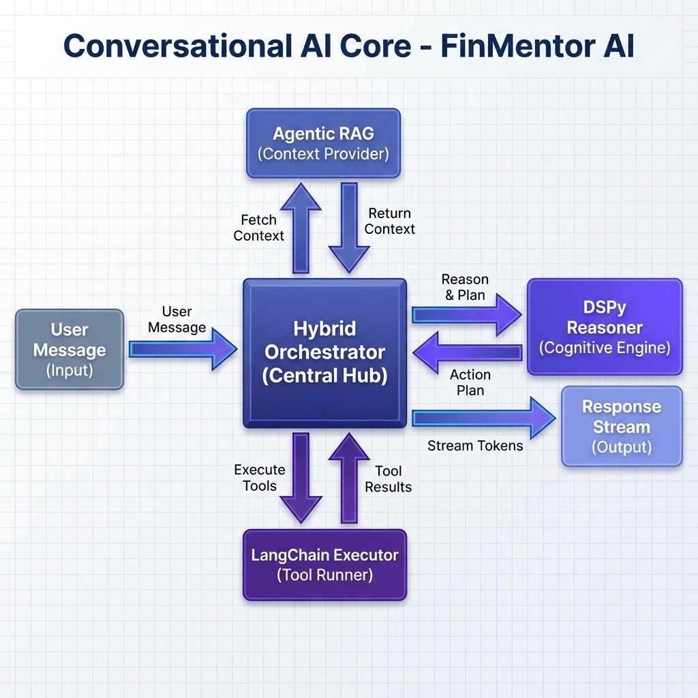
Multi-Agent Design High Level Overview

Slide 12
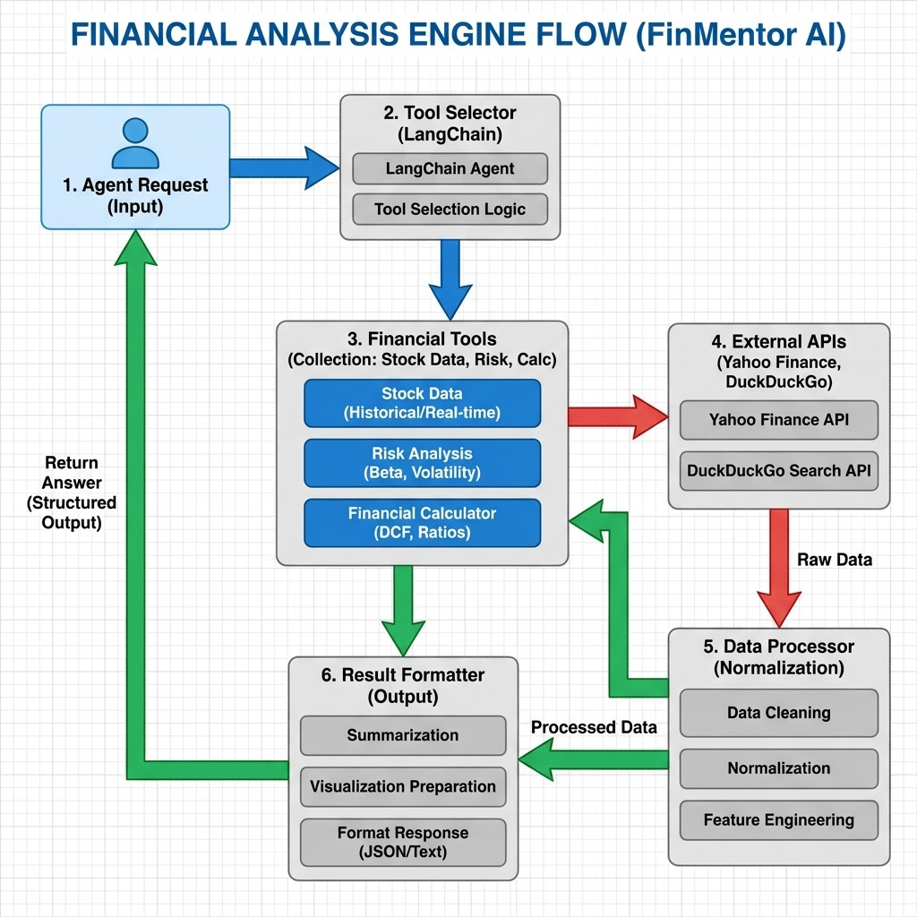
Multiagent Module
Multi-Agent System Orchestrator Key Responsibilities
  Complex assessment: Classifies as simple, moderate, complex, critical.
  Agent selection: Maps query intent to required agents.
  Dependency resolution: Identifies which agents depend on others
  Rate limiting: Gemini 10 request/minute.
  Parallel execution: Independent agents run simultaneously.
  Result synthesis: Combines output from all agents.

Slide 13
Technology Stack
Component/Framework | Technology or Feature
Frontend (Web) | React + Vite + Tailwind CSS
Backend Framework | FastAPI (Python 3.9+)
Database | PostgreSQL 14+
ORM | SQLAlchemy
Authentication | JWT (PyJWT library)
LLM Framework | Google Gemini API (REST calls)
Agent Framework | LangChain
Market Data | yfinance Python library
Deployment | Heroku / Railway / Render (free tier)
Version Control | Git + GitHub
DSPy | Structured reasoning AI framework (introduced 2023)
Backend Framework: FastAPI (Python 3.10+)
Reason: Async support, fast, auto-generates API docs
Database: PostgreSQL
AI/ML Components:
Google Gemini API (gemini-1.5-flash) - Free tier, Query classification, response generation
LangChain - Agent orchestration framework
DSPY – Structured Reasoning AI Framework
Security:
Passwords: bcrypt hashing with salt
API Authentication: JWT tokens
Environment variables for API keys

Slide 14
Future Scope
Multi-model agents: Full integration of chart analysis for a seamless, human-like interaction.
Tax-Loss Harvesting Agent: A specialized agent to monitor portfolios and suggest tax-efficient trades.
Mobile Application: Native React Native app for on-the-go portfolio management.
Blockchain Integration: For verifying immutable audit trails of financial advice
Advanced Portfolio Optimization: Implementing Black-Litterman and Mean-Variance Optimization models for institutional-grade portfolio construction.

Slide 15
Thank You

